Slide 1
Predicting Loan Repayment (BMO Case Study)
- By Prerit Saxena

Slide 2
Project Objective:
The objective of this project is to predict the loan repayment status. This is to help the business anticipate bad loans in advance and minimize risk.
Data Structure: There are three components of the data
Loan characteristics
Loan amount
Interest rate
Term
Borrower characteristics
Annual income
Debt-to-income ratio
State
Banking activity
No. of installment accounts
No. of open trades
No. of revolving accounts
Data Quality:
The analysis considers loans which are complete(Either fully paid or charged off). It does not include ongoing loans
Only 43% of the columns has robust data for conducting analysis
Missing values have been imputed to make a better prediction
The Target variable – Loan status is highly unbalanced(>80% Fully paid vs <20% charged off) and hence, balancing techniques have been used for modelling.

Slide 3
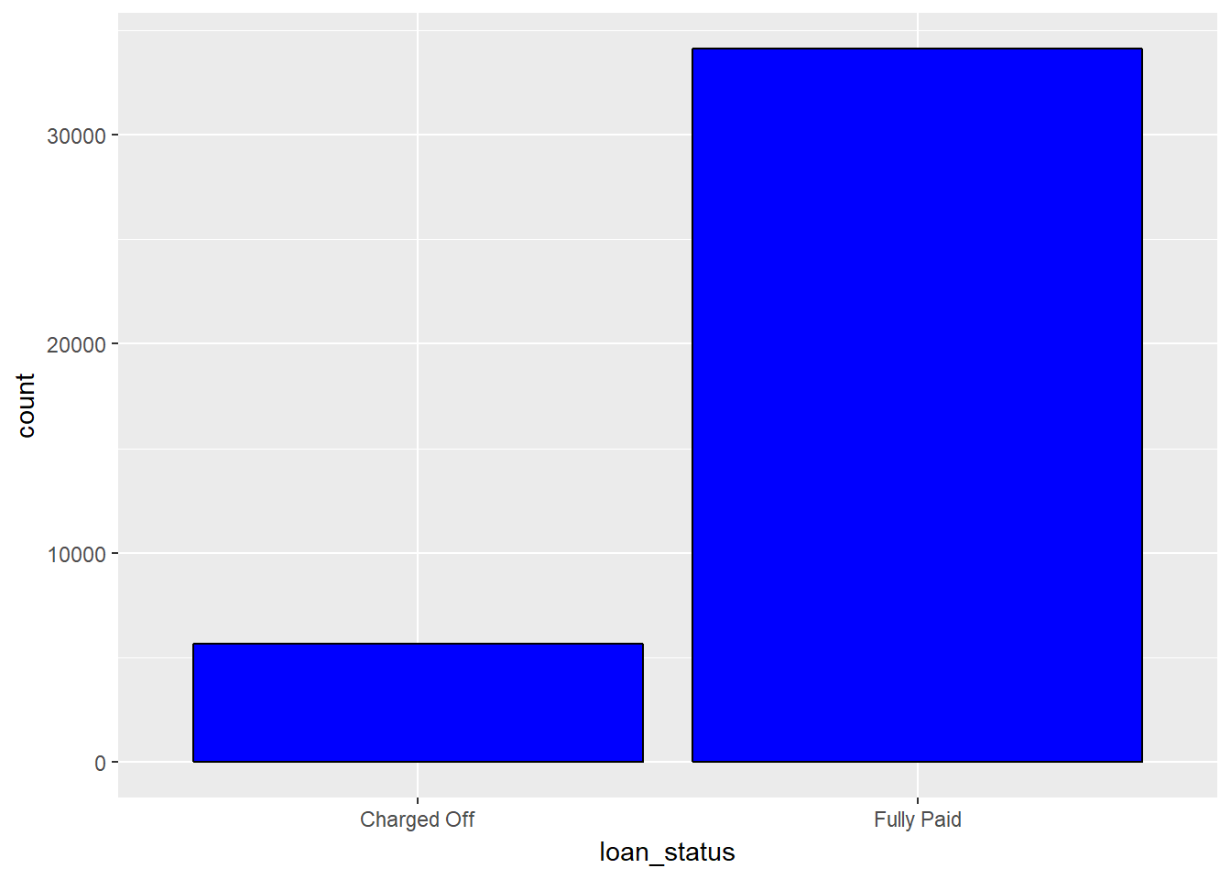
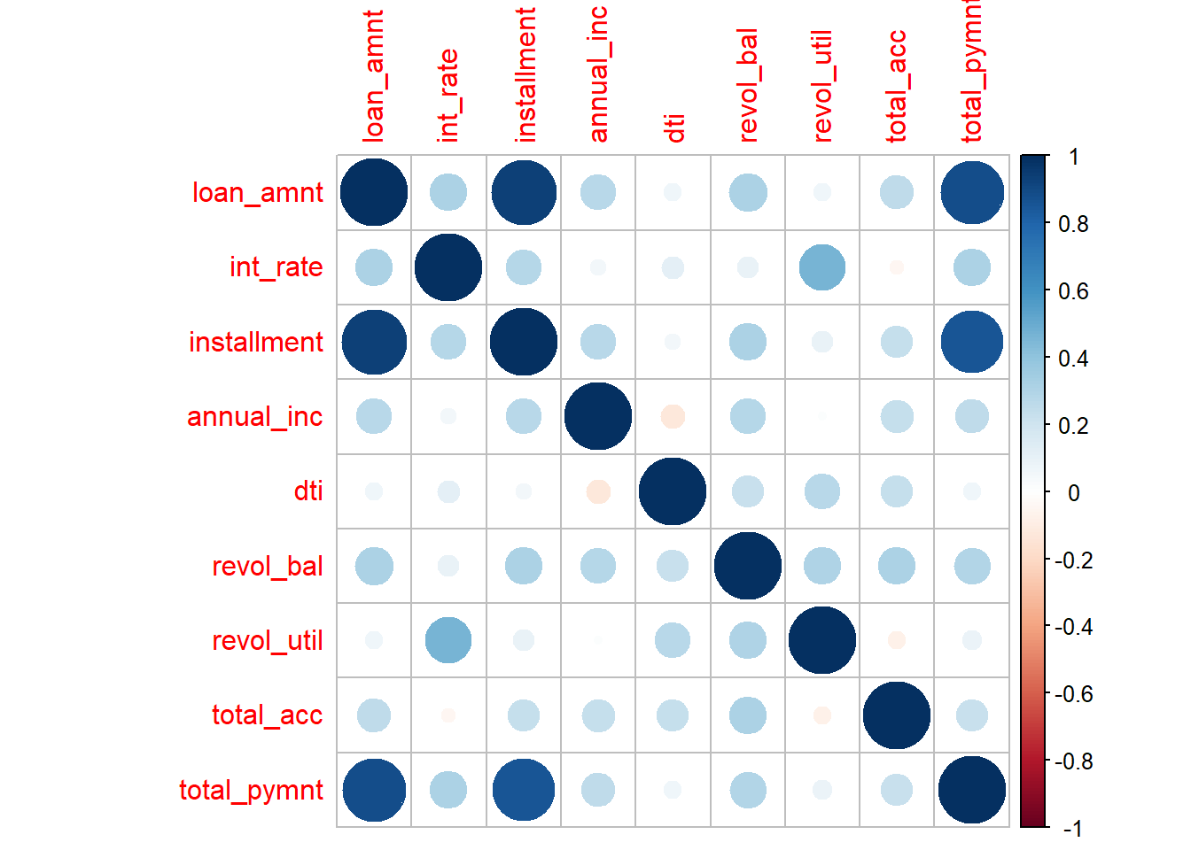
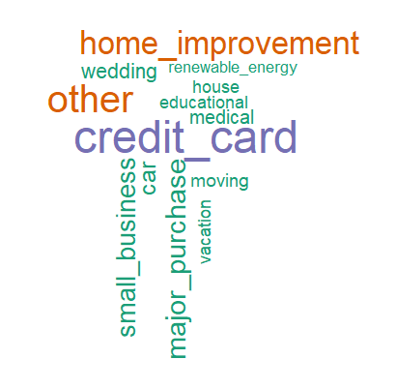
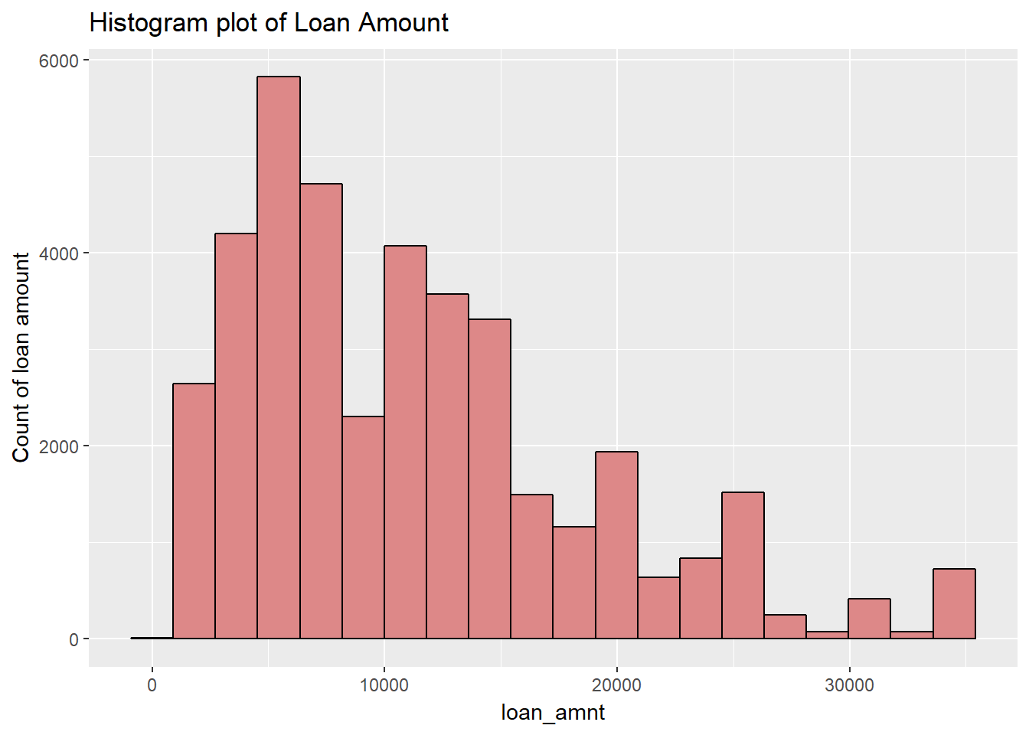
Lot of fully paid loans, small loan amounts and credit card debt consolidation summarize the dataset
Quick summary:
>80% loans in the data are fully paid
Biggest uses of the loans from this department has been credit card debt consolidation
Hence, possibly most of the loans are small loans( 0 - $10,000)
There is an obvious correlation between loan amount, installment and payment
However, we can also see that a large revolving utilization leads to a possible increase in interest rate
A large number of people have an employment history of over 10 years

Slide 4
Logistic Regression gives best classification with an accuracy of 68%
Summary of the modelling process:
Under-represented class in loan status has been increased in number to balance Fully Paid and Charged off loans
Advanced sampling techniques have been used for the above process
The objective of the project can be accomplished by using classification algorithms. Three of those have been used here
Apart from maximizing the accuracy, we also need to minimize False Positive Rate which is – no. of loans classified as Fully Paid but are actually Charged Offs.
Logistic Regression
Most important factors:
Model Characteristics:
Decision Trees
Most important factors:
Model Characteristics:
Random Forest
Most important factors:
Model Characteristics:
Total late fee
Revolving utilization
Inquiries last 6 months
Accuracy: 68%
False Positive Rate: 46%
Accuracy: 65%
False Positive Rate: 60%
Accuracy: 50%
False Positive Rate: 0.06%
Sub-grade
Inquiries last 6 months
Borrower’s state
Sub-grade
Inquiries last 6 months
Borrower’s state

Slide 5
Conclusion and Future Scope
Conclusion
Inquiries in last 6 months and Sub-Grade are most important factors for determining whether a loan will be repaid in full or charged off
Keeping number of loans which are identified as fully paid but are actually charged-offto a minimum can help minimize risk for the bank
Few states like Ohio, Texas and Vermont have higher number of charged off loans and hence, lending process can be scrutinized to reduce bad loans
Future Scope
Text analysis can be performed on purpose and description to see if there is a connection between this and loan status
Ensemble methods(combining multiple models) can be used for improving accuracy
Additional factors like regular late payments and change in credit history can prove useful in predicting bad loans

